Slide 1
Paper Figures
40 Topics

Slide 2
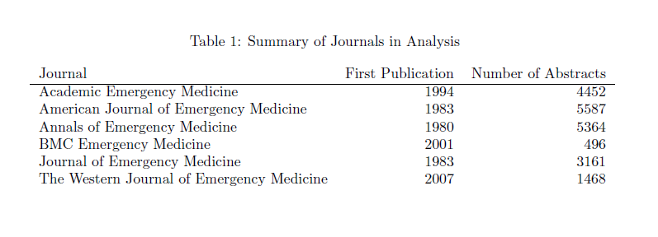
Table 1

Slide 3
Table 2

Slide 4
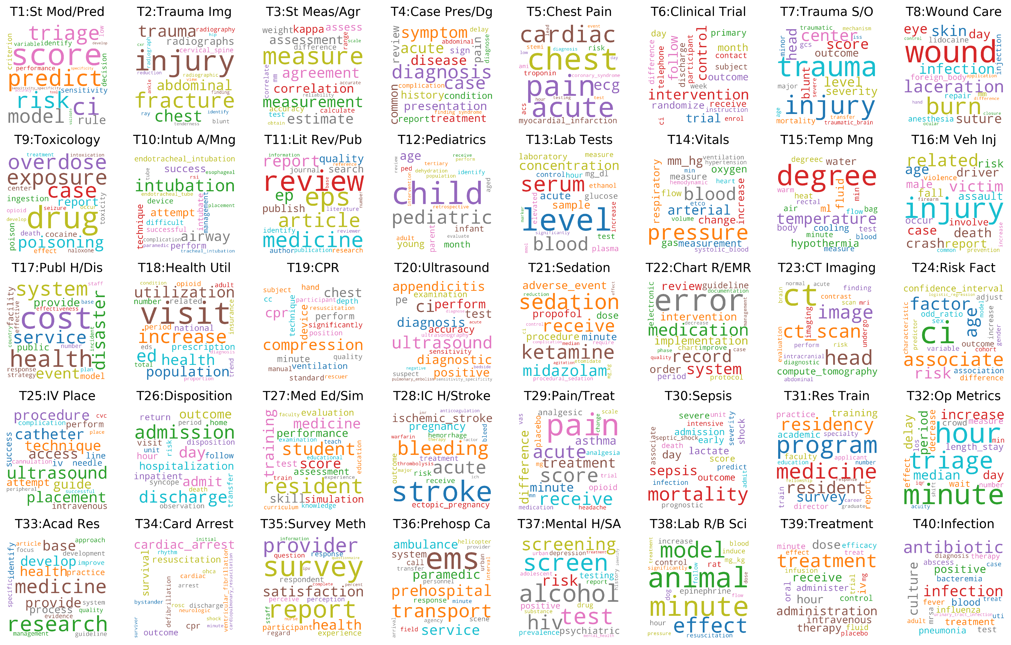
Figure 1 Word Clouds

Slide 5
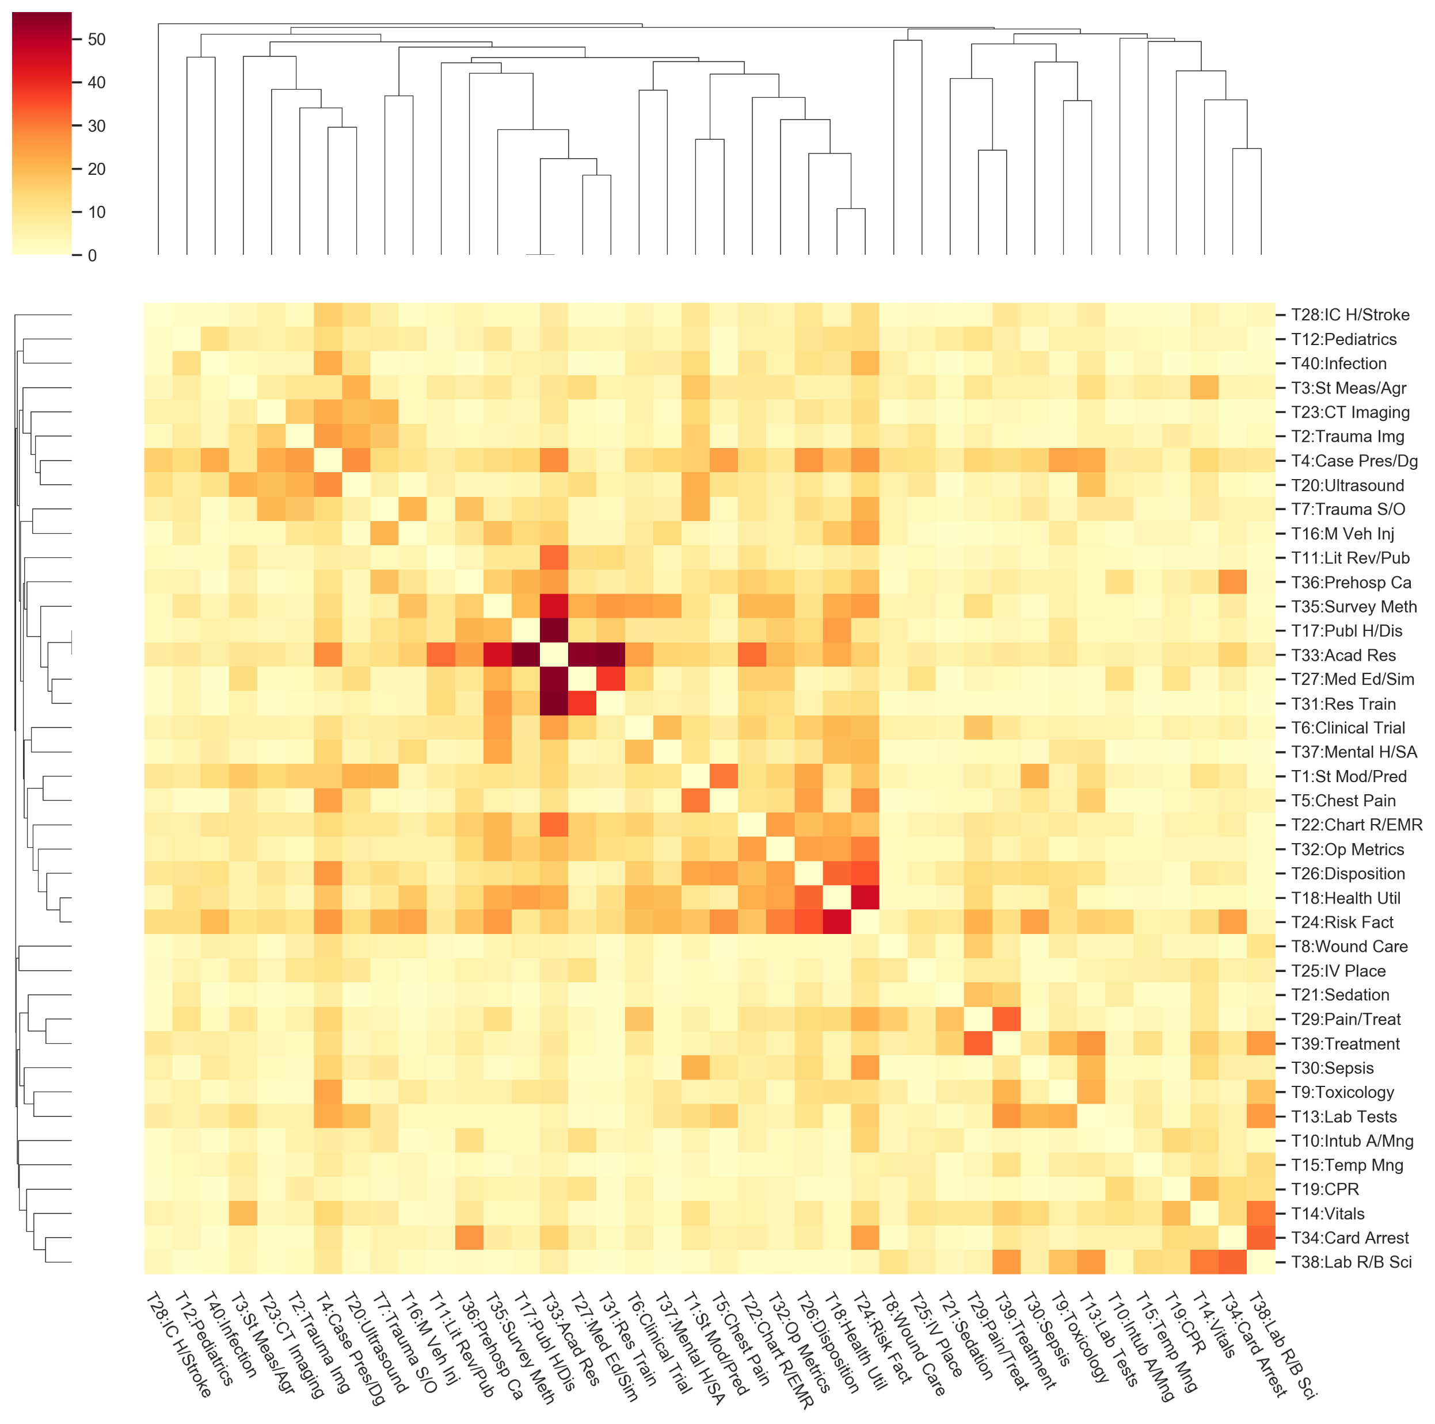
Figure 2 Topic cluster heatmap

Slide 6
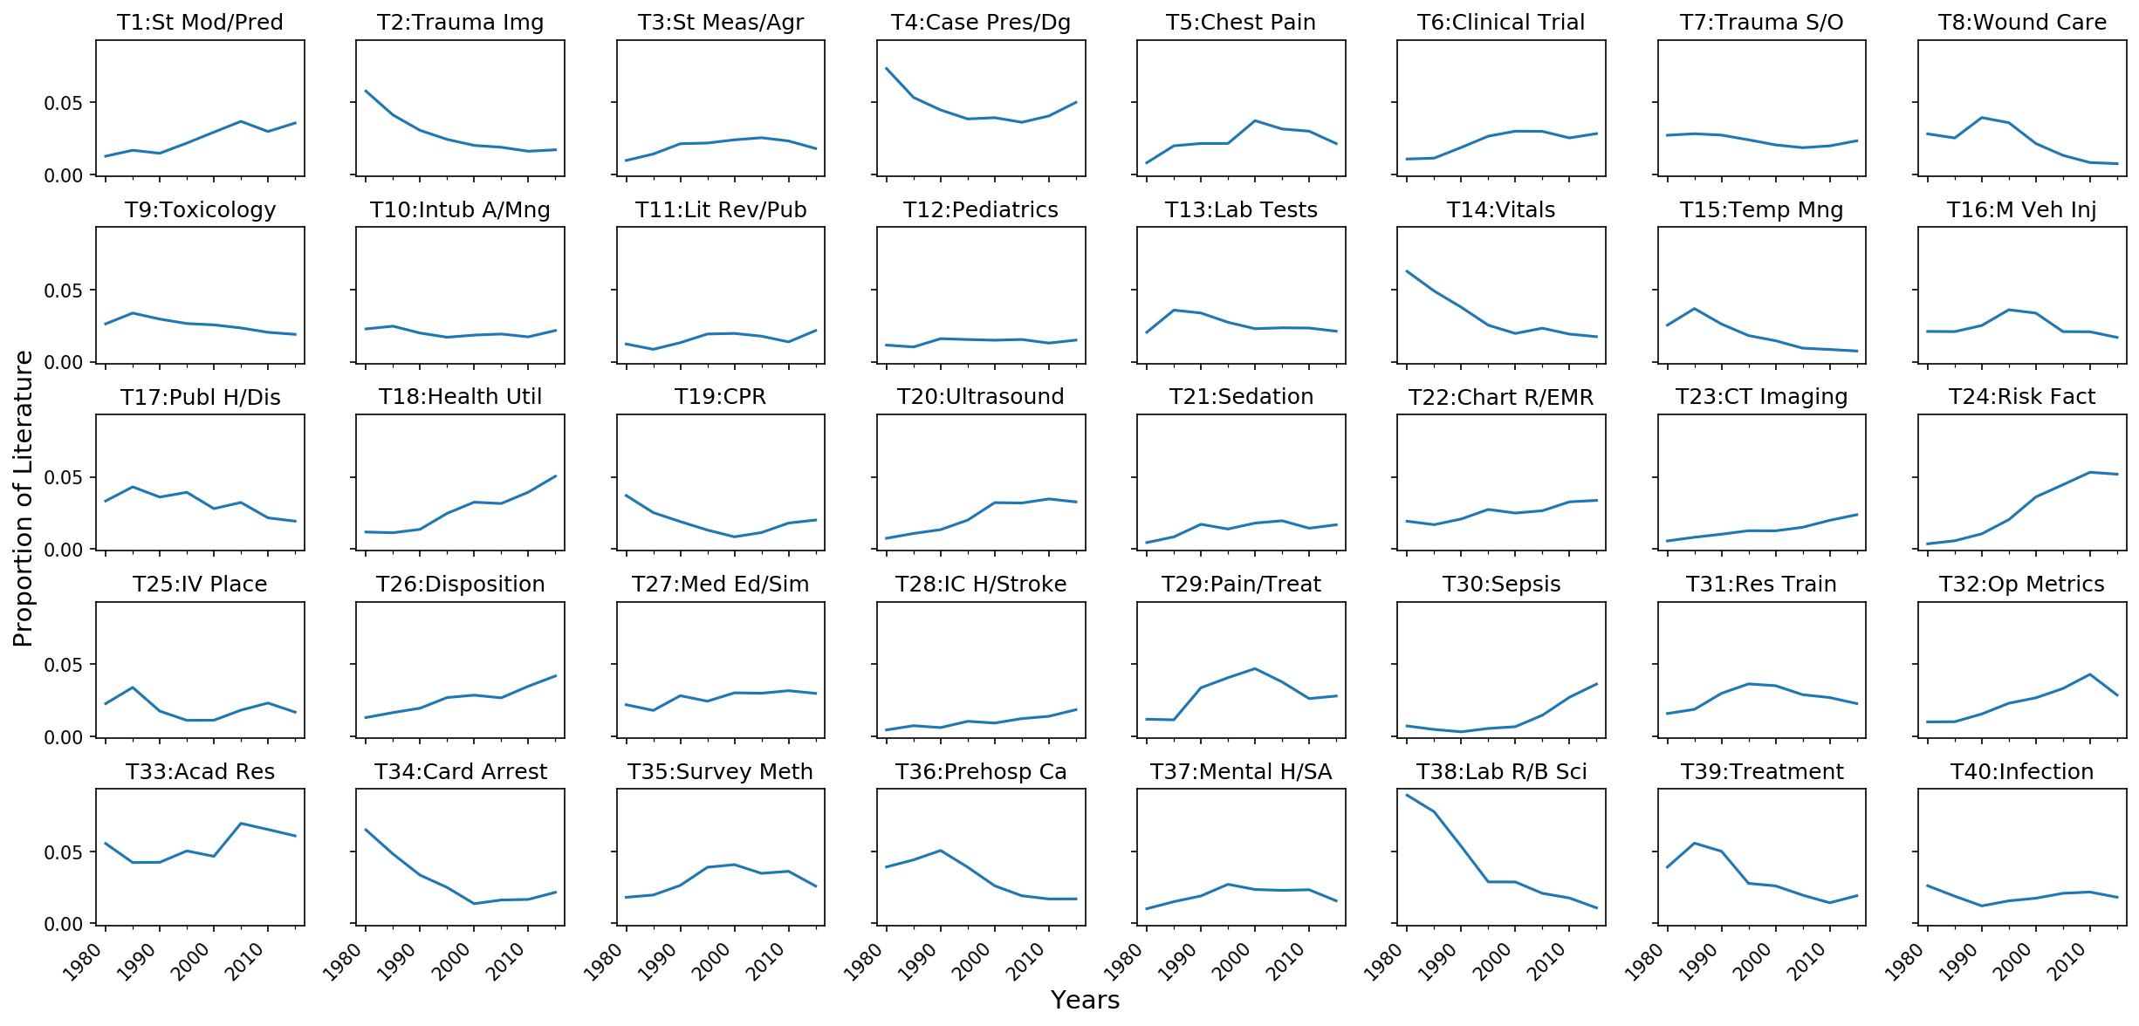
Figure 3 Topic Trends

Slide 7
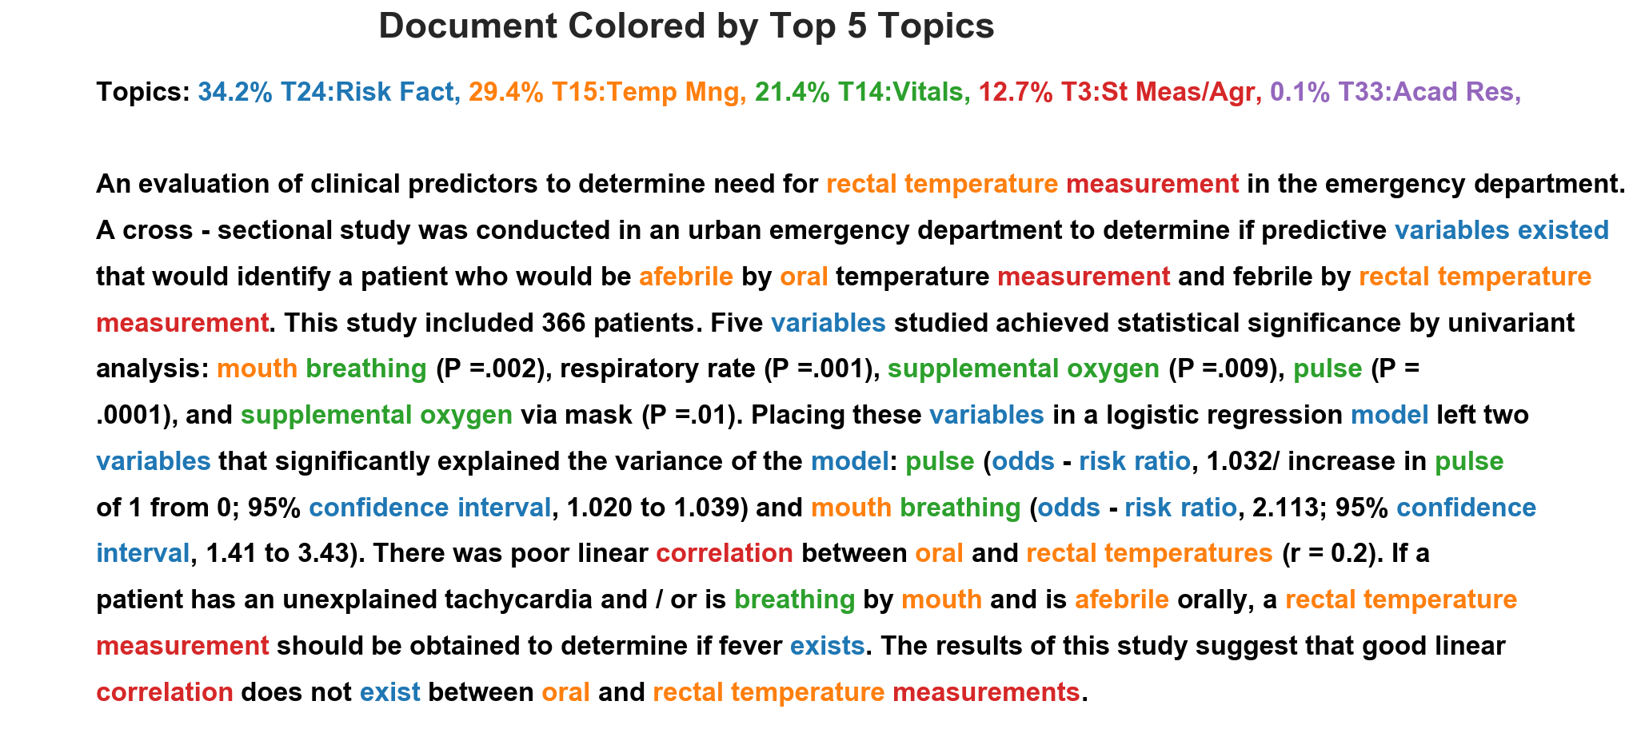
Figure 4 example Paragraph 6545

Slide 8
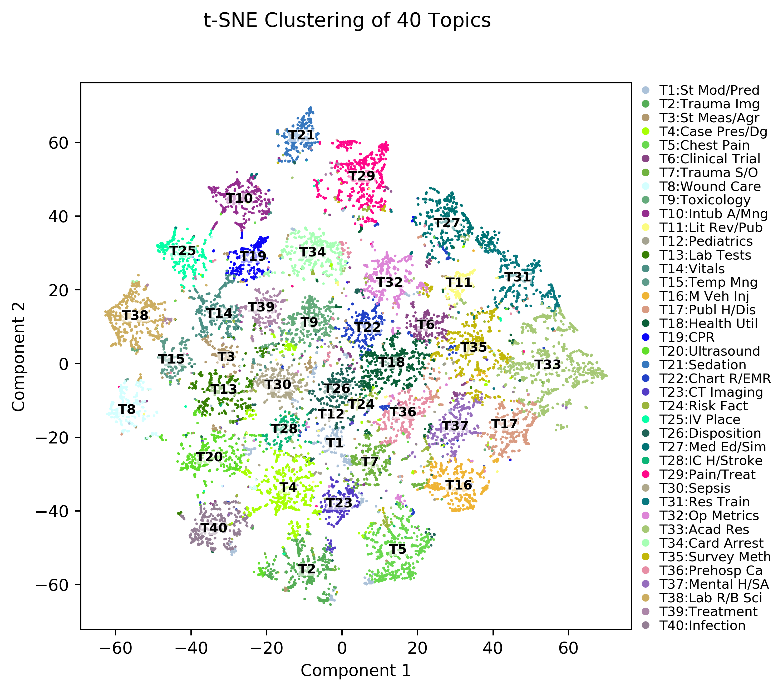
Figure 5 t-SNE cluster of documents

Slide 9
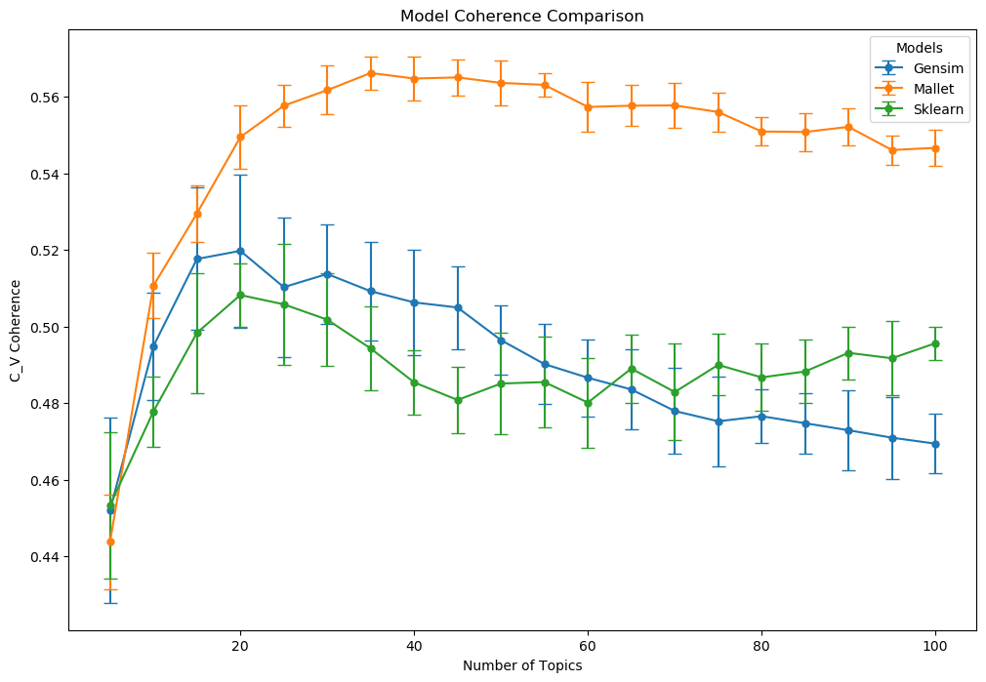
Supplemental Figure 1

Slide 10
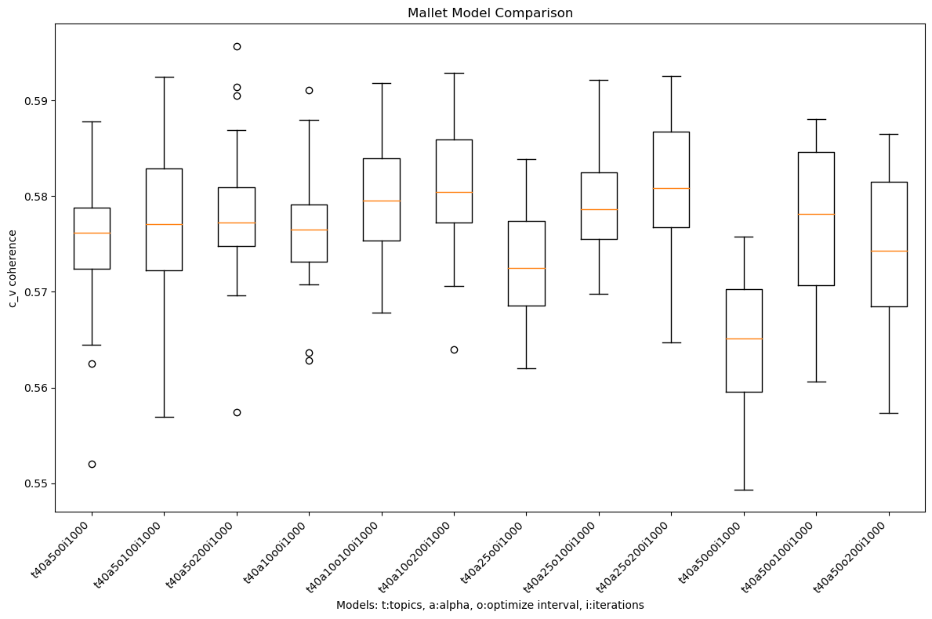
Supplemental Figure 2

Slide 11
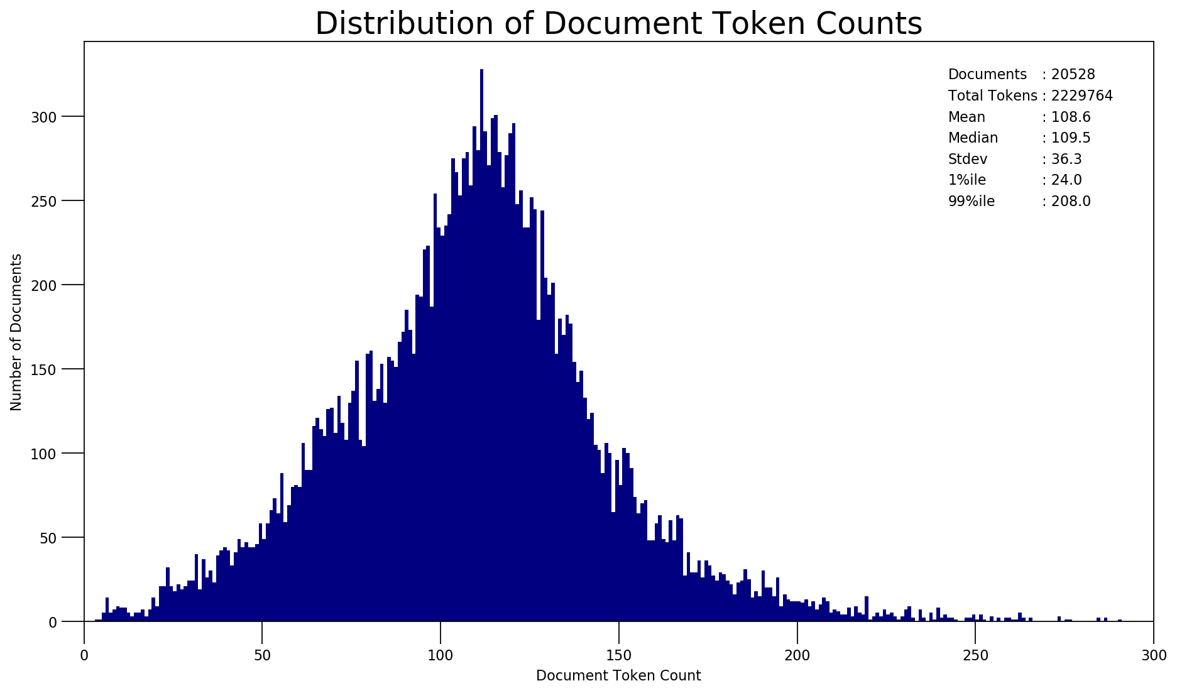
Supplemental Figure 3

Slide 12
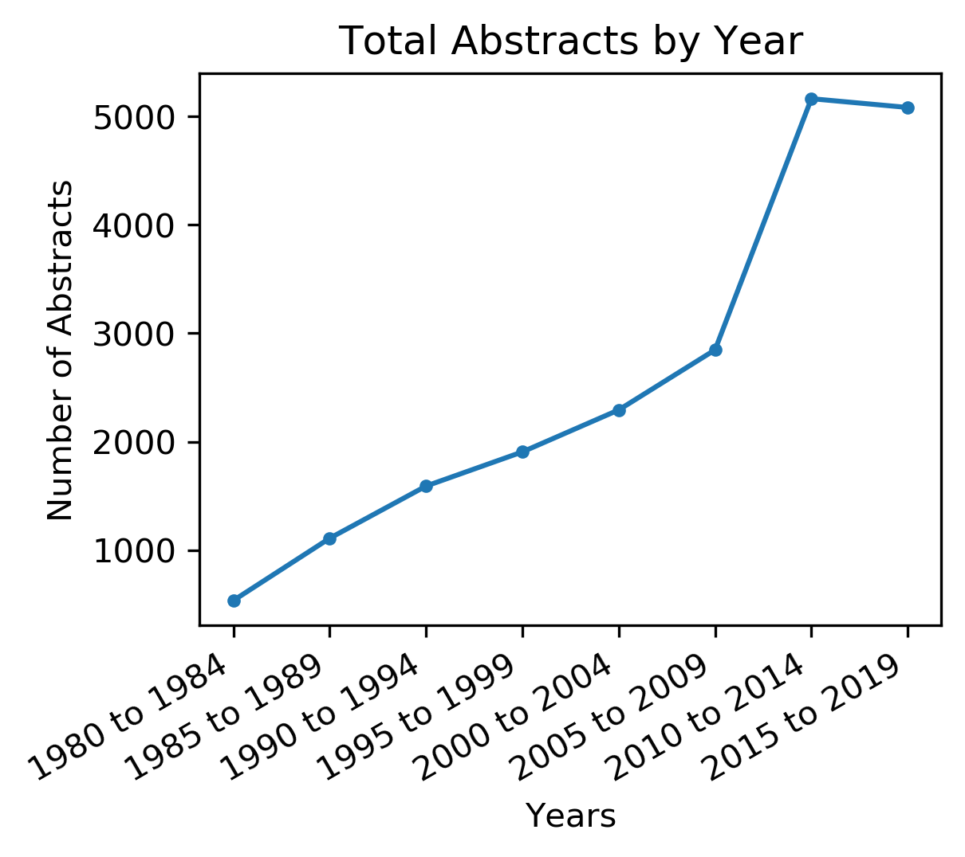
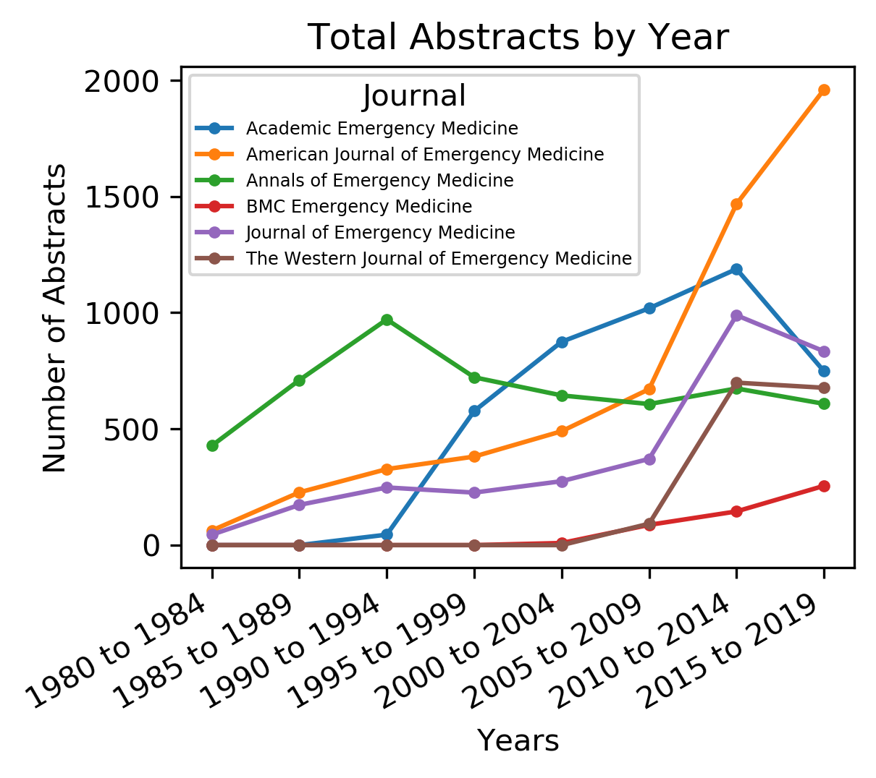
Supplemental Figure 4

